Slide 1
Natural Language Processing
Unit 4 Working in NLP
Faizan Javed
DataScience @ SMU

Slide 2
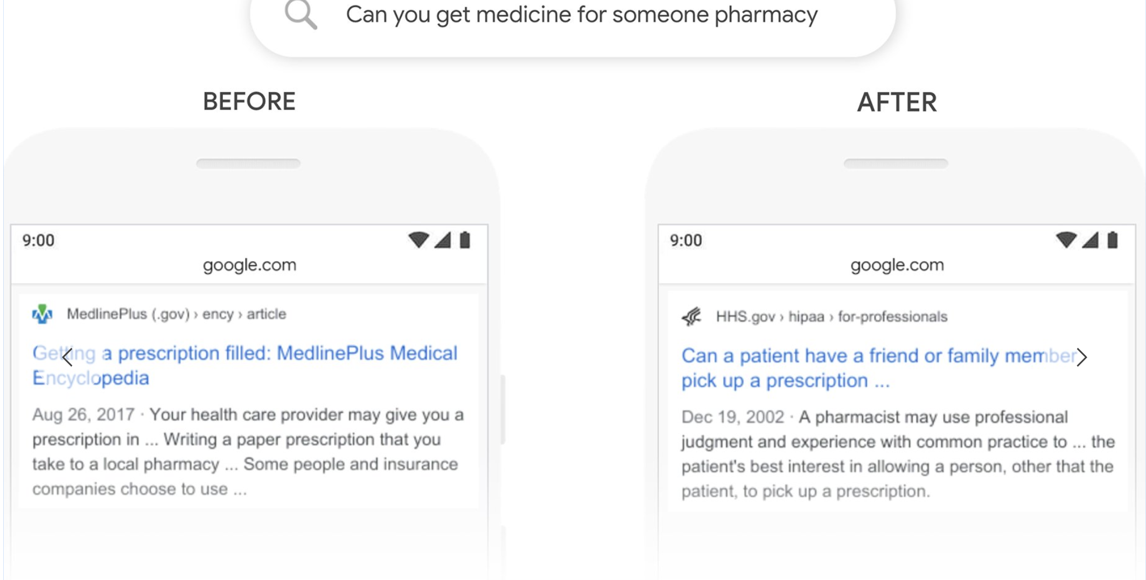
Industry use cases – Web and Enterprise Search
Notes:
IADS workshop KDD 2019 https://www.iadss.org/kdd-2019-presentations

Slide 3
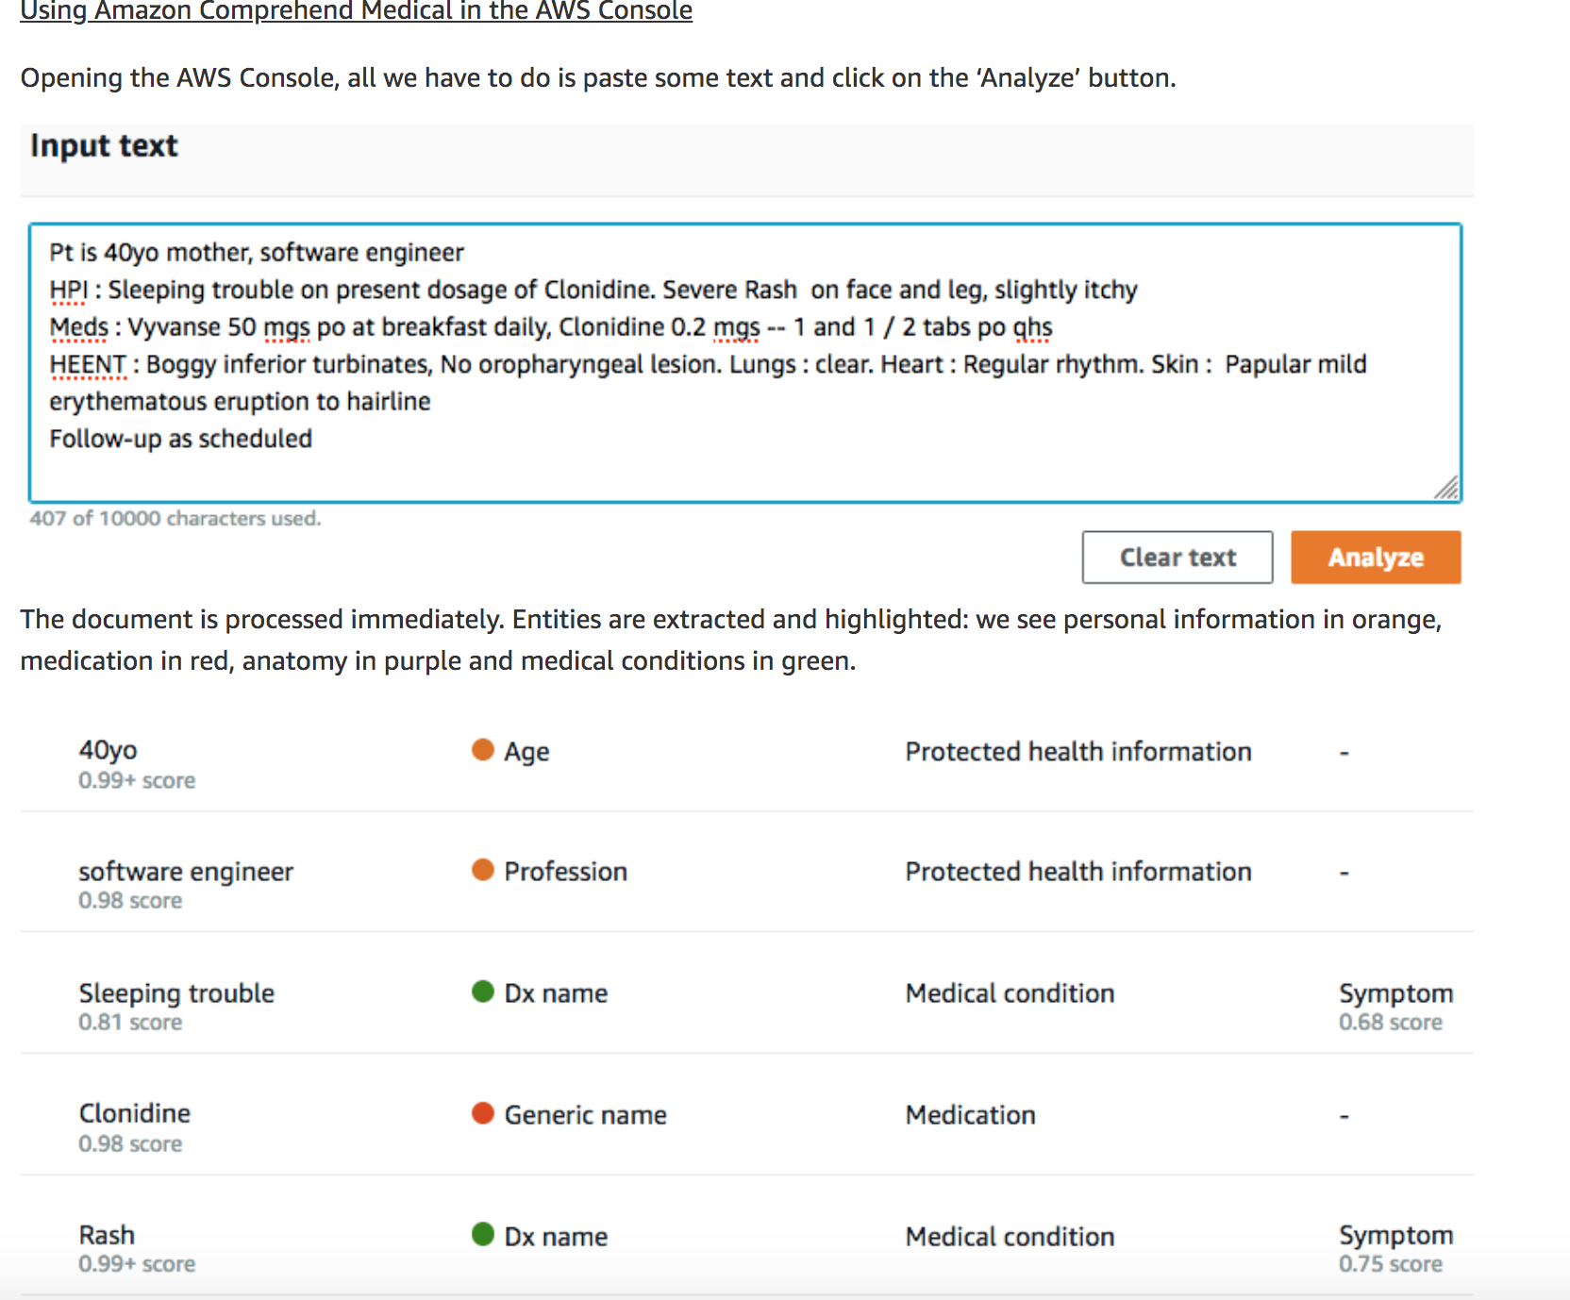
Industry use cases – Healthcare
Notes:
IADS workshop KDD 2019 https://www.iadss.org/kdd-2019-presentations

Slide 4
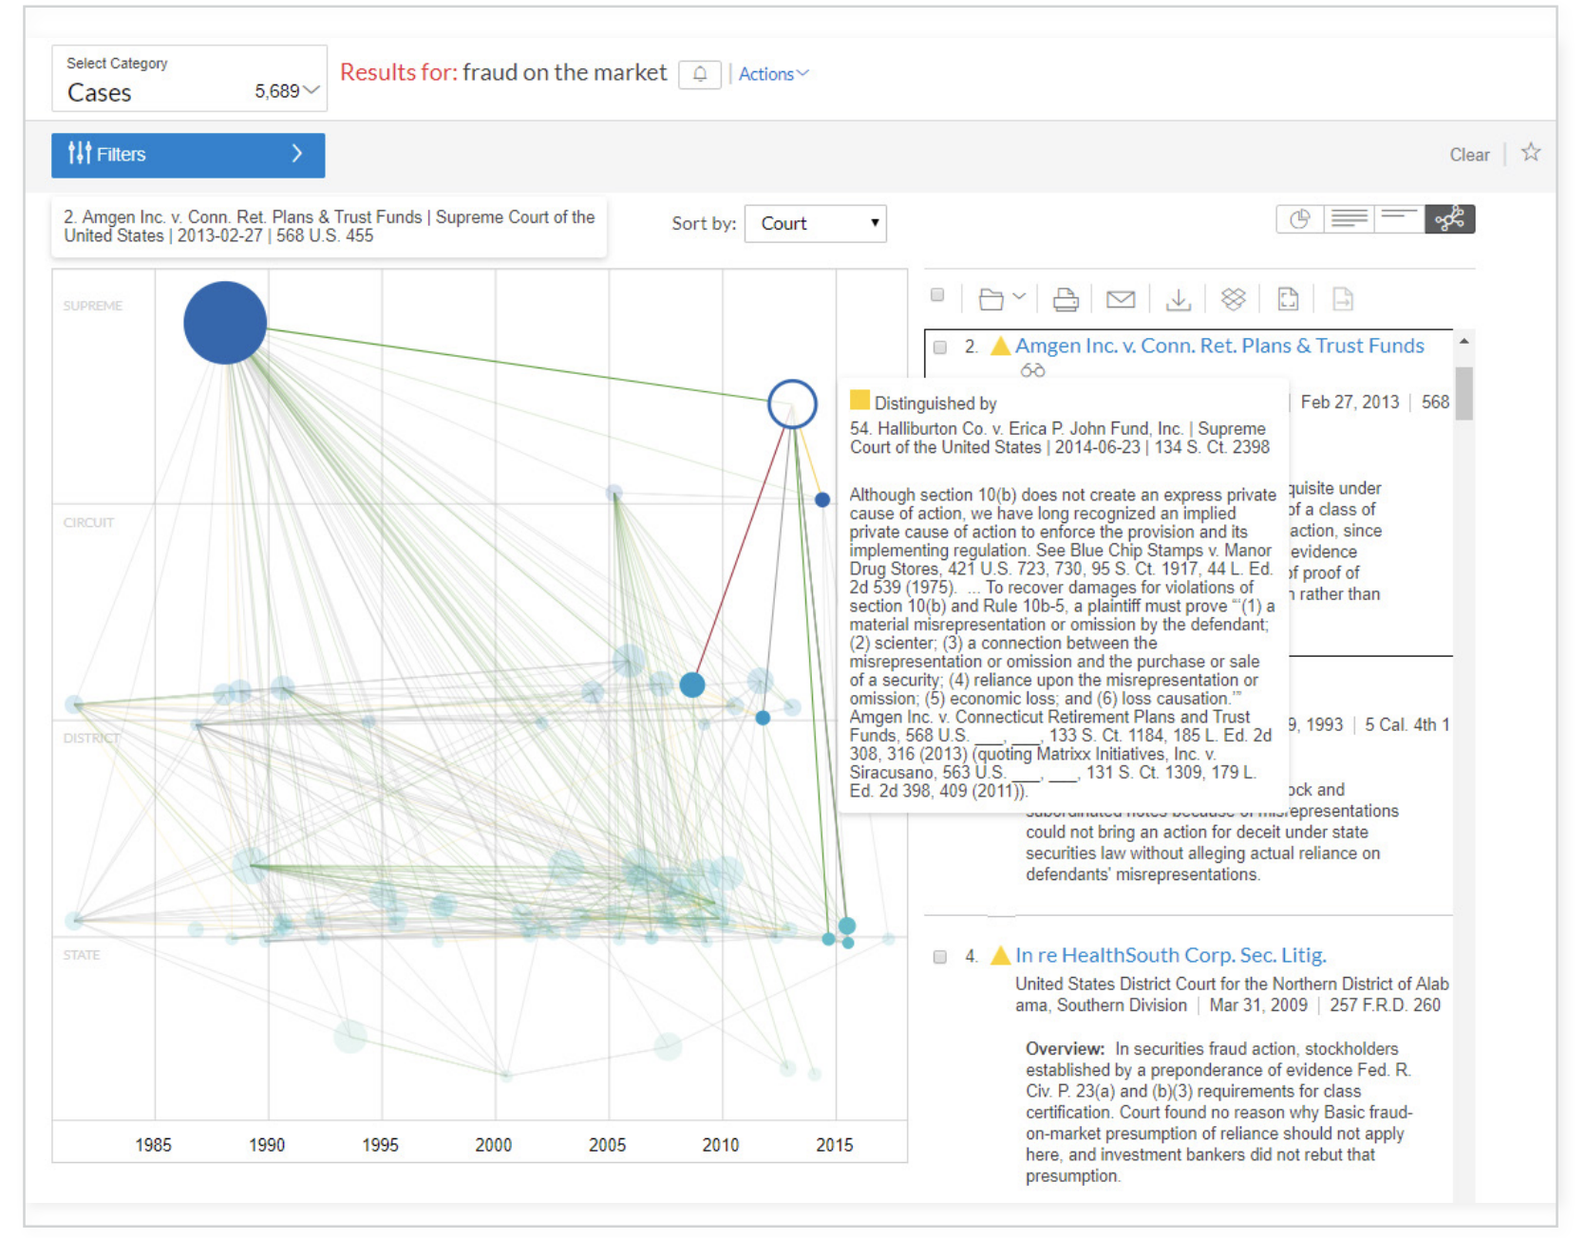
Industry use cases – Legal
Notes:
IADS workshop KDD 2019 https://www.iadss.org/kdd-2019-presentations

Slide 5
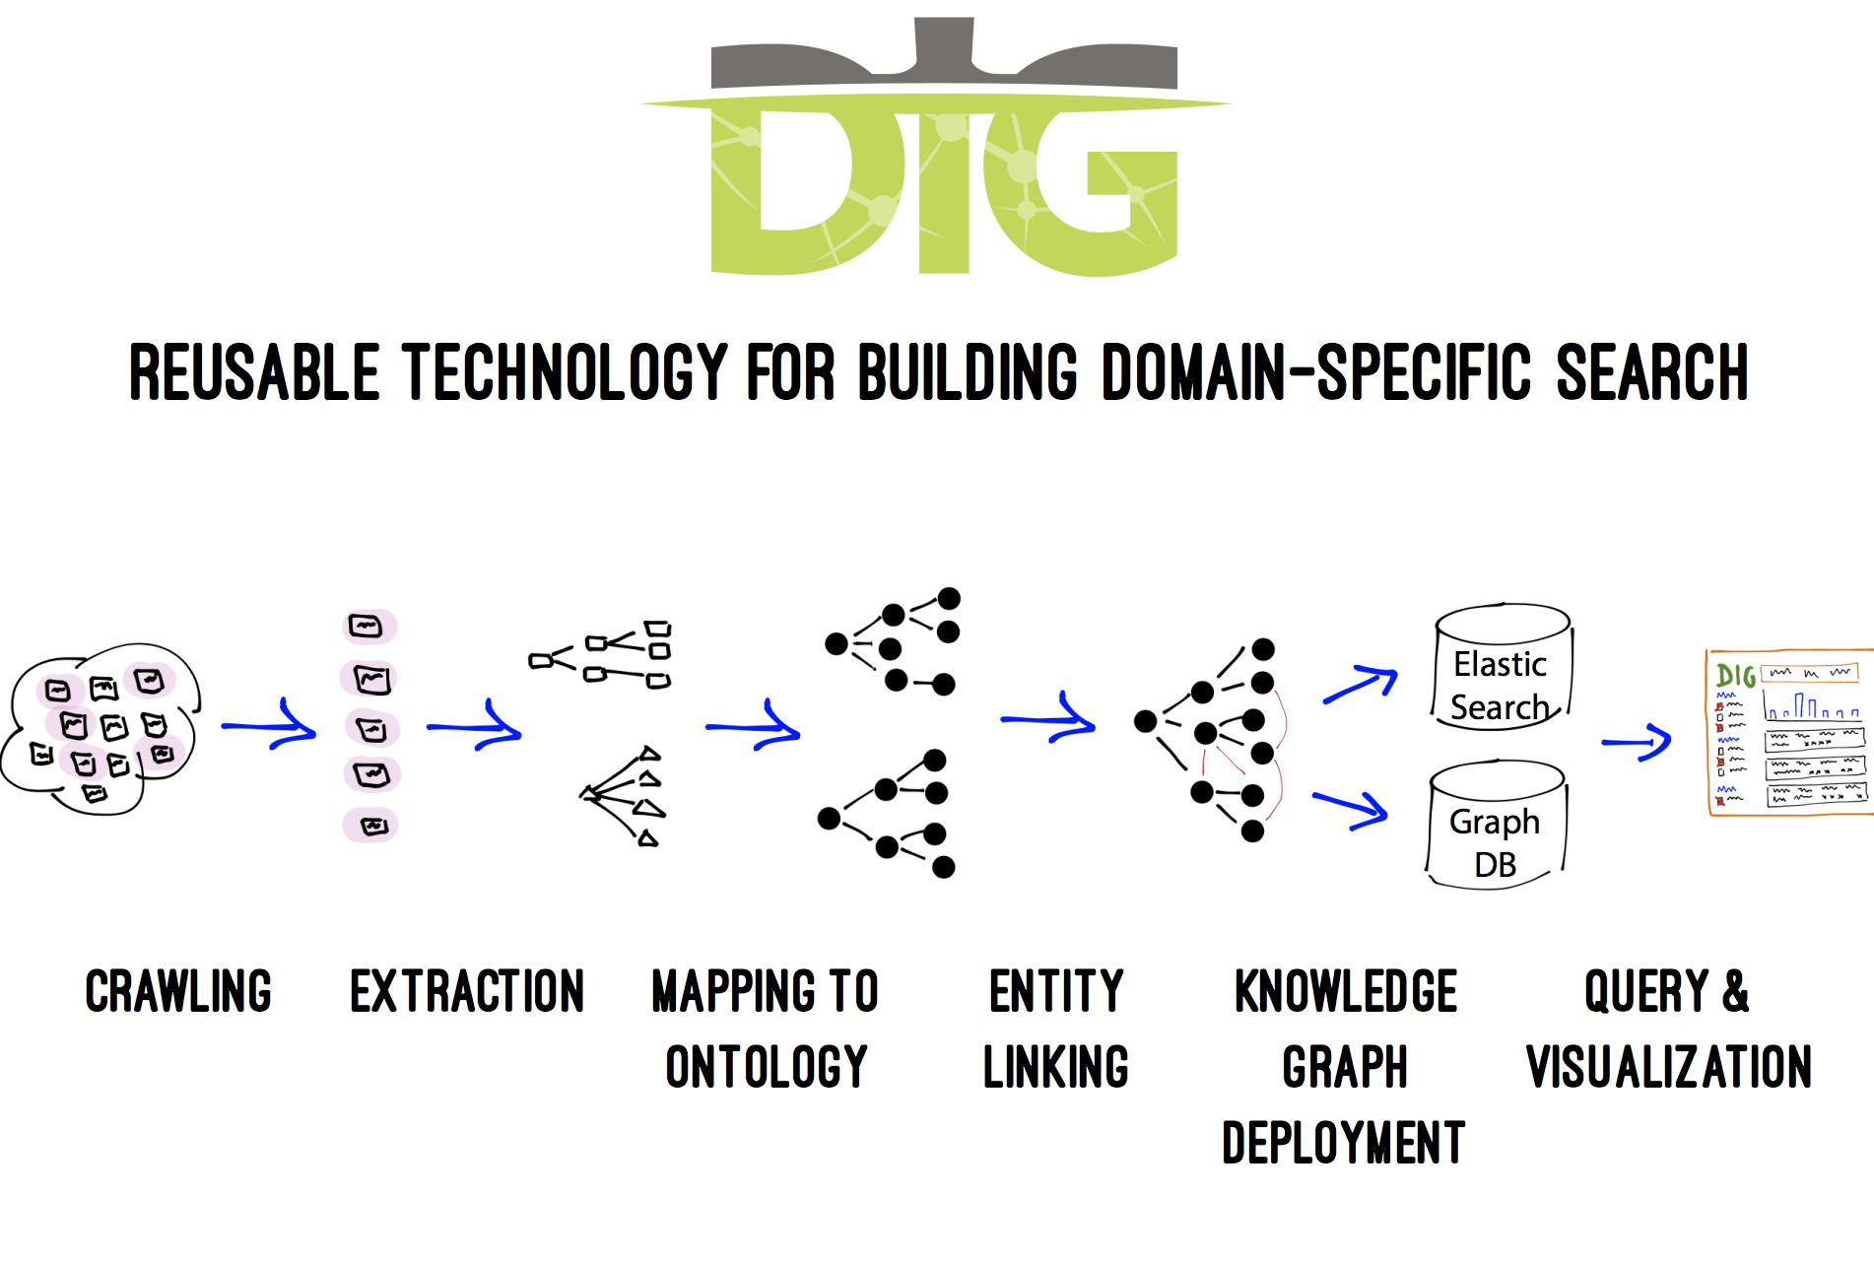
Industry use cases – Law enforcement/human trafficking
Notes:
IADS workshop KDD 2019 https://www.iadss.org/kdd-2019-presentations

Slide 6
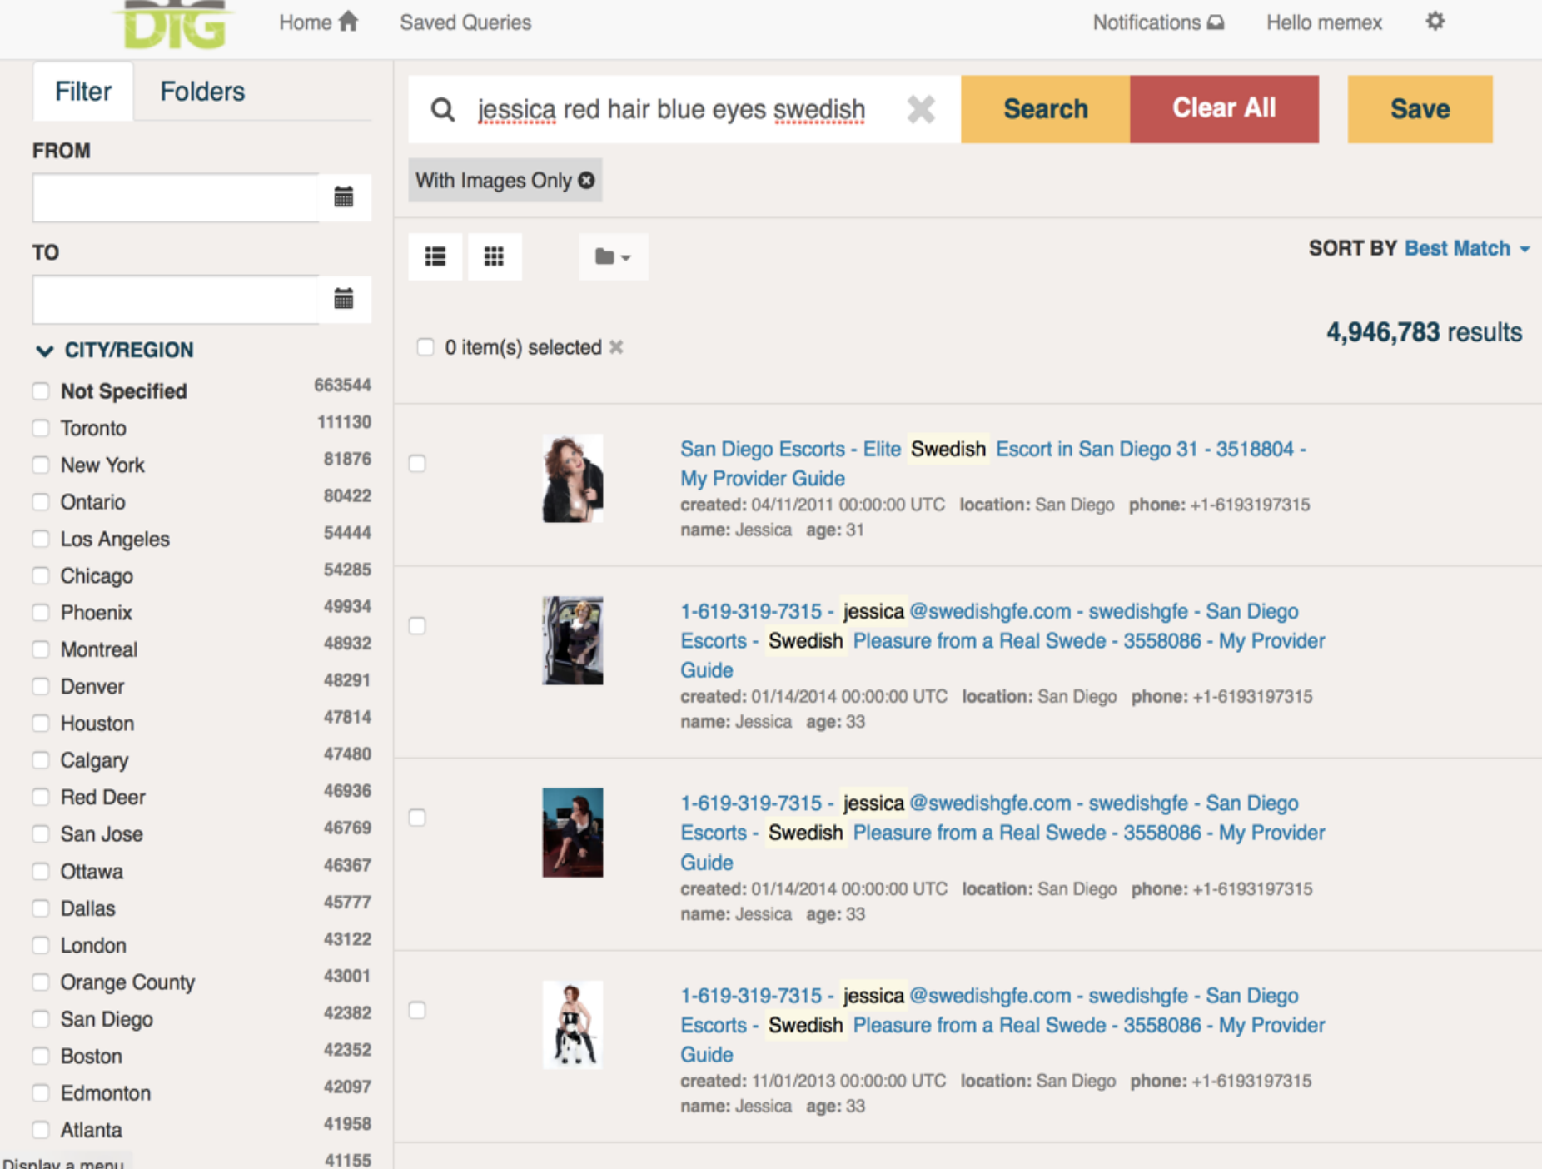
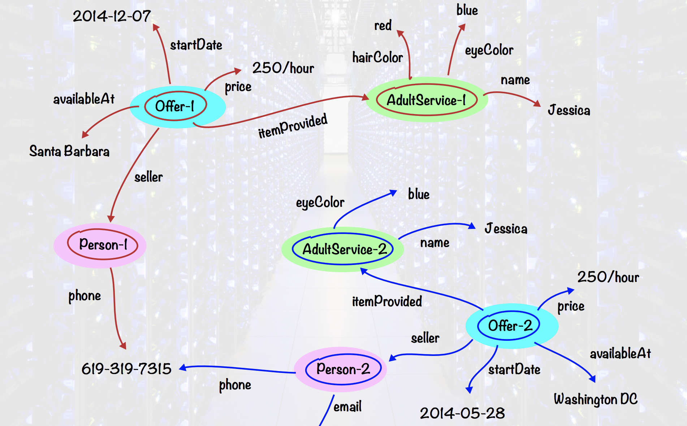
Industry use cases – Law enforcement/human trafficking
Notes:
IADS workshop KDD 2019 https://www.iadss.org/kdd-2019-presentations

Slide 7
Industry use cases – Conversational AI ref. kore.ai

Slide 8
Industry use cases – Conversational AI (ecommerce)
Notes:
IADS workshop KDD 2019 https://www.iadss.org/kdd-2019-presentations

Slide 9
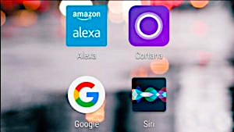
Virtual Assistants

Slide 10
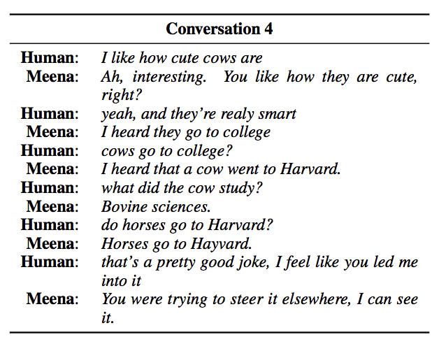
Industry use cases – Google Meena
Google Meena: Towards a Conversational Agent that Can Chat About…Anything
https://ai.googleblog.com/2020/01/towards-conversational-agent-that-can.html
Notes:
IADS workshop KDD 2019 https://www.iadss.org/kdd-2019-presentations

Slide 11
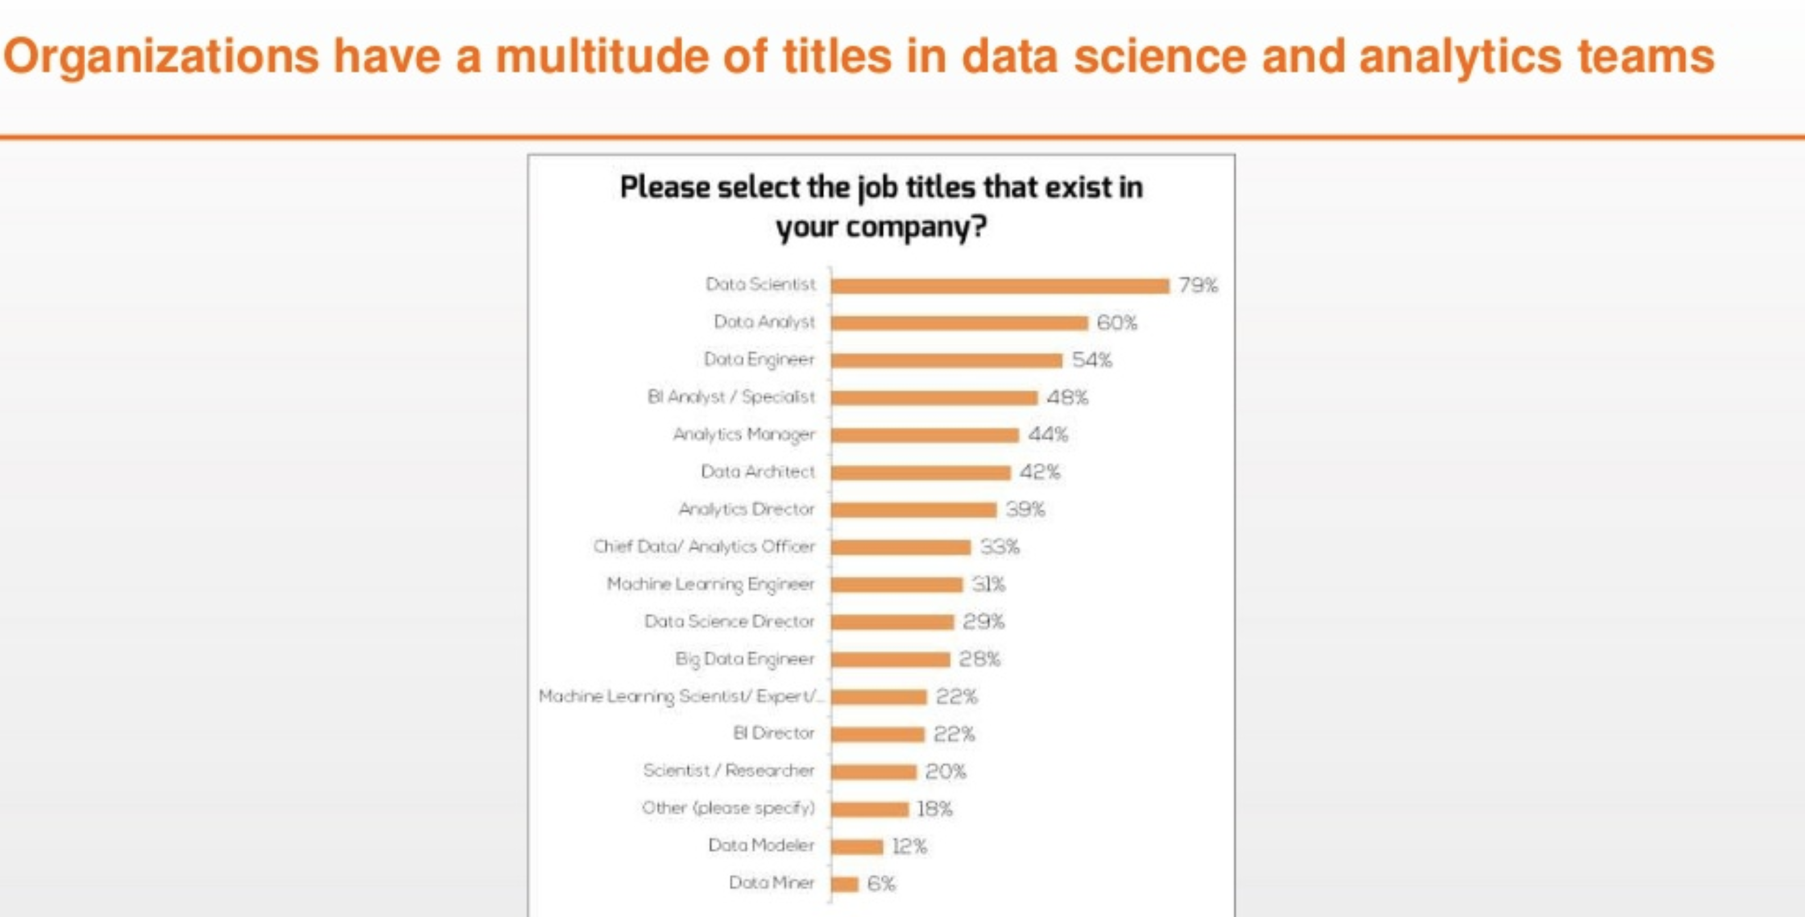
Jobs using NLP
Notes:
IADS workshop KDD 2019 https://www.iadss.org/kdd-2019-presentations

Slide 12
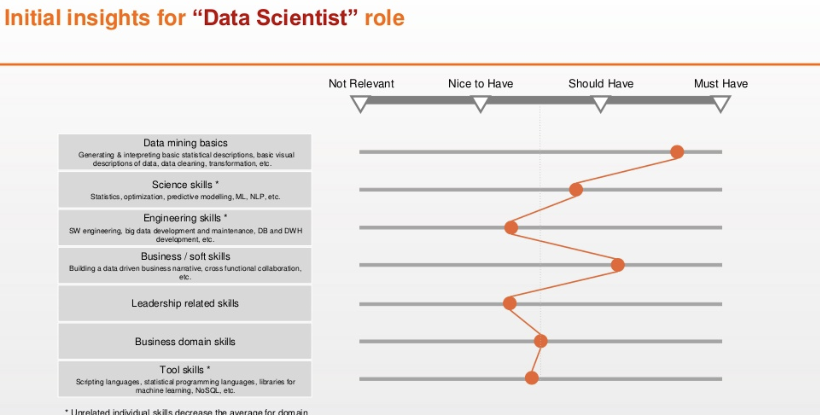

Slide 13
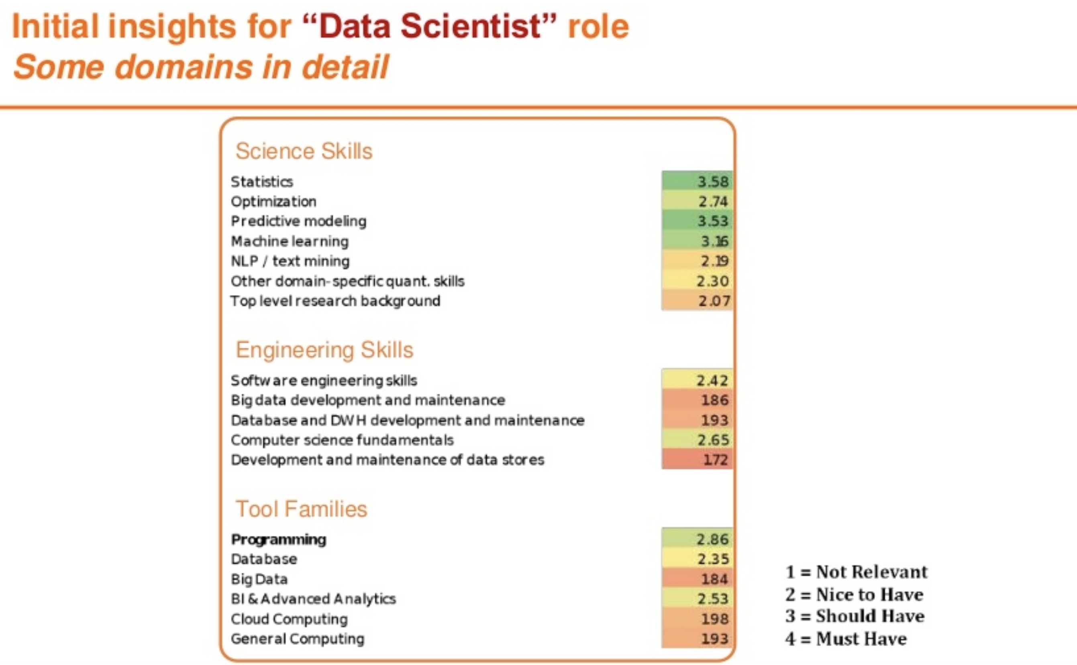

Slide 14
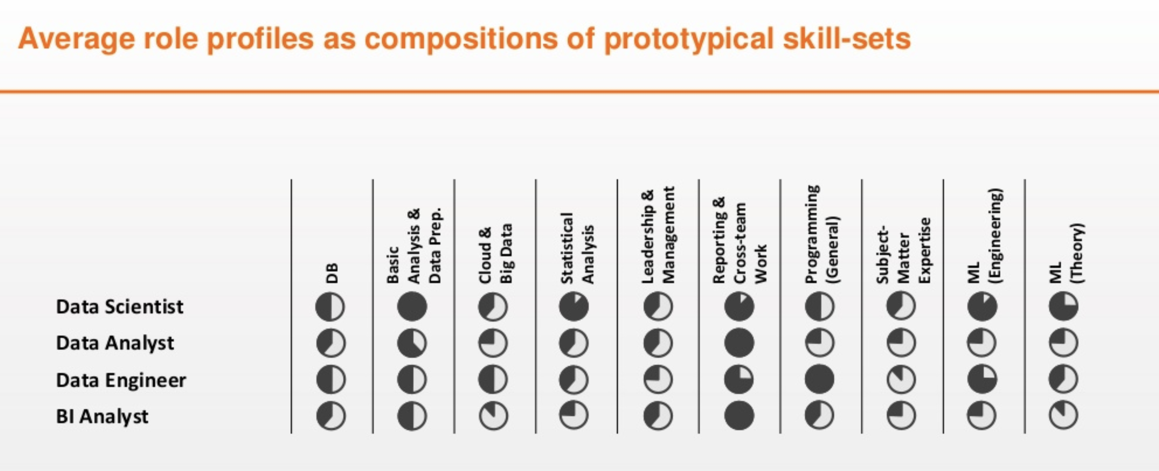

Slide 15
Notes:
https://www.oreilly.com/radar/data-engineers-vs-data-scientists/

Slide 16
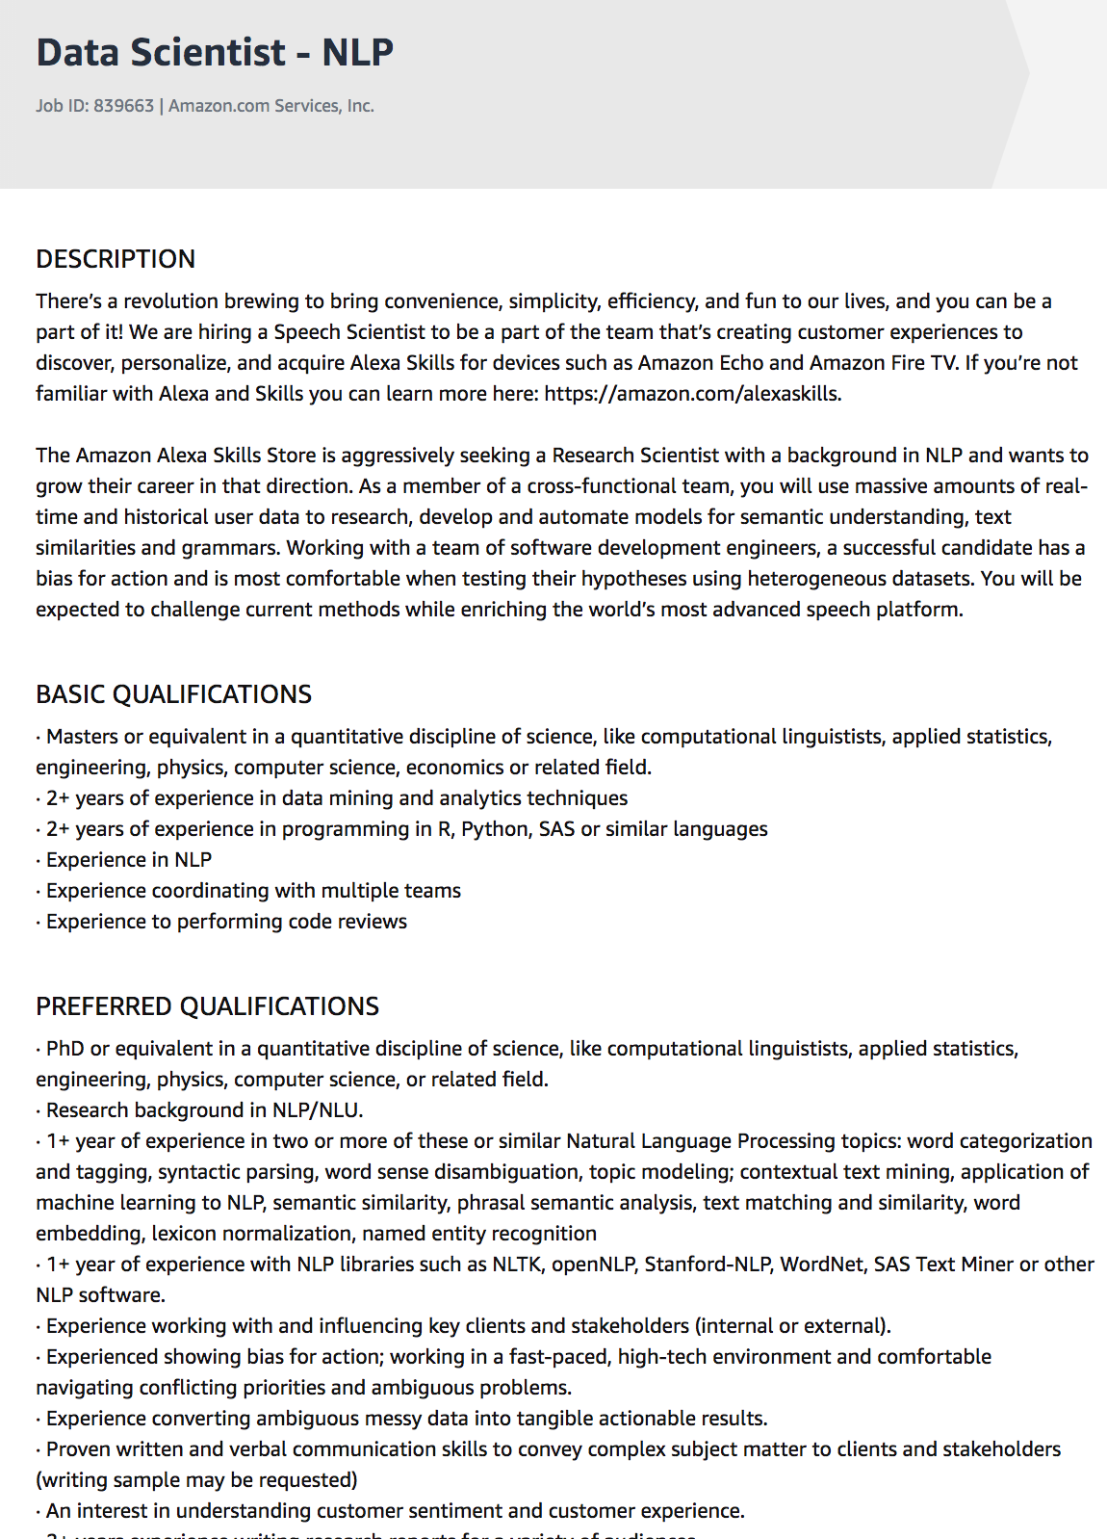
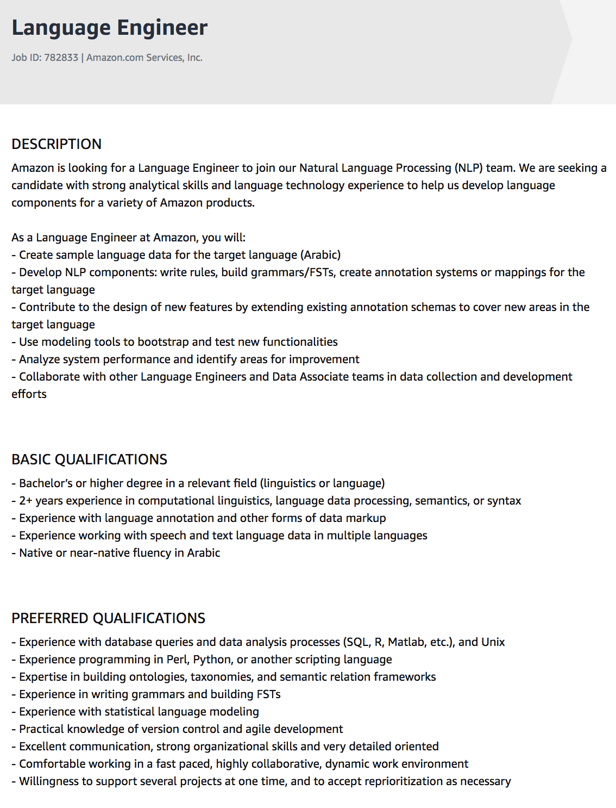
Notes:
https://www.oreilly.com/radar/data-engineers-vs-data-scientists/

Slide 17
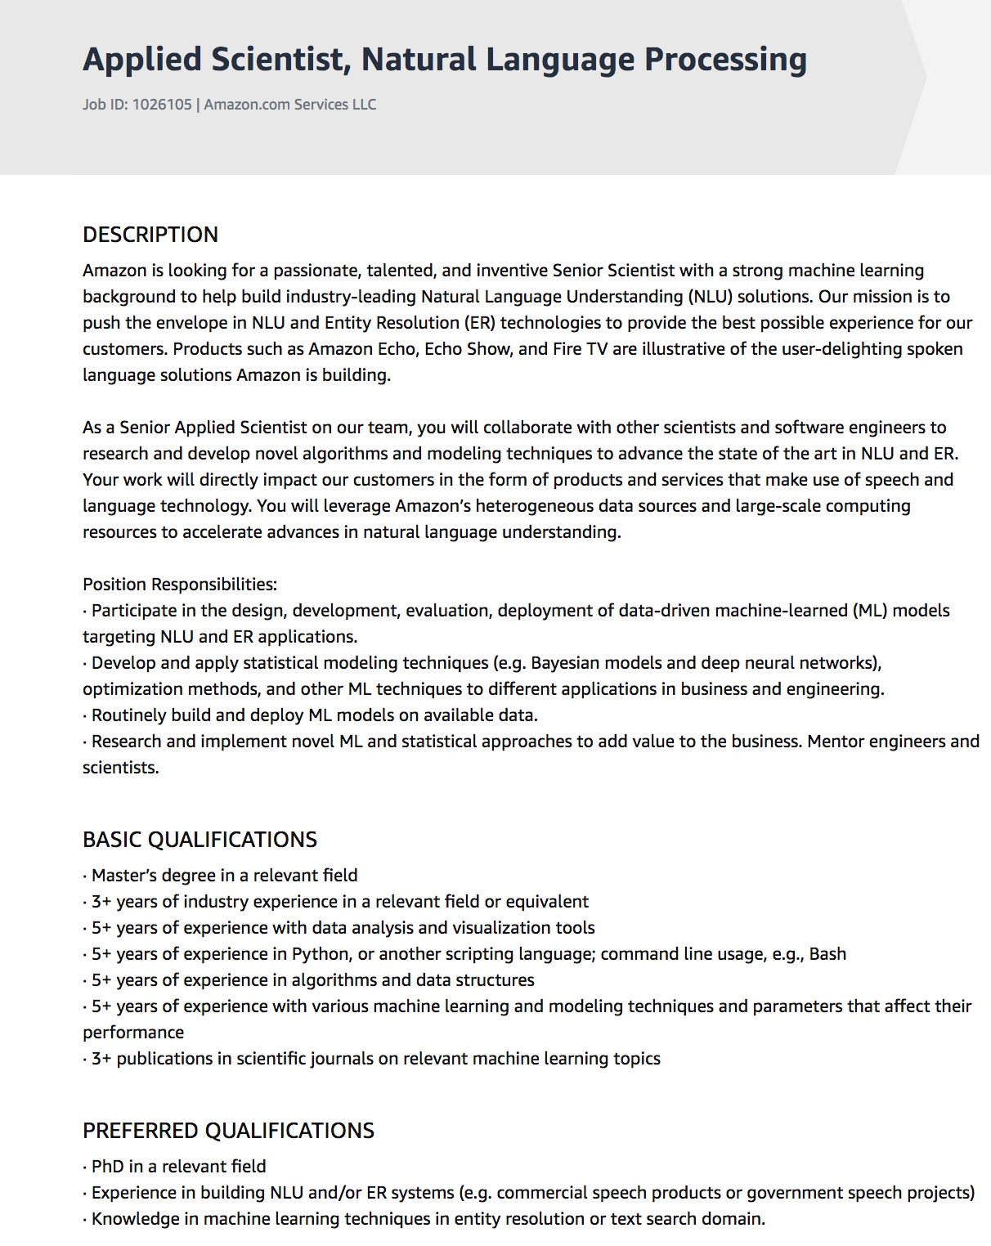
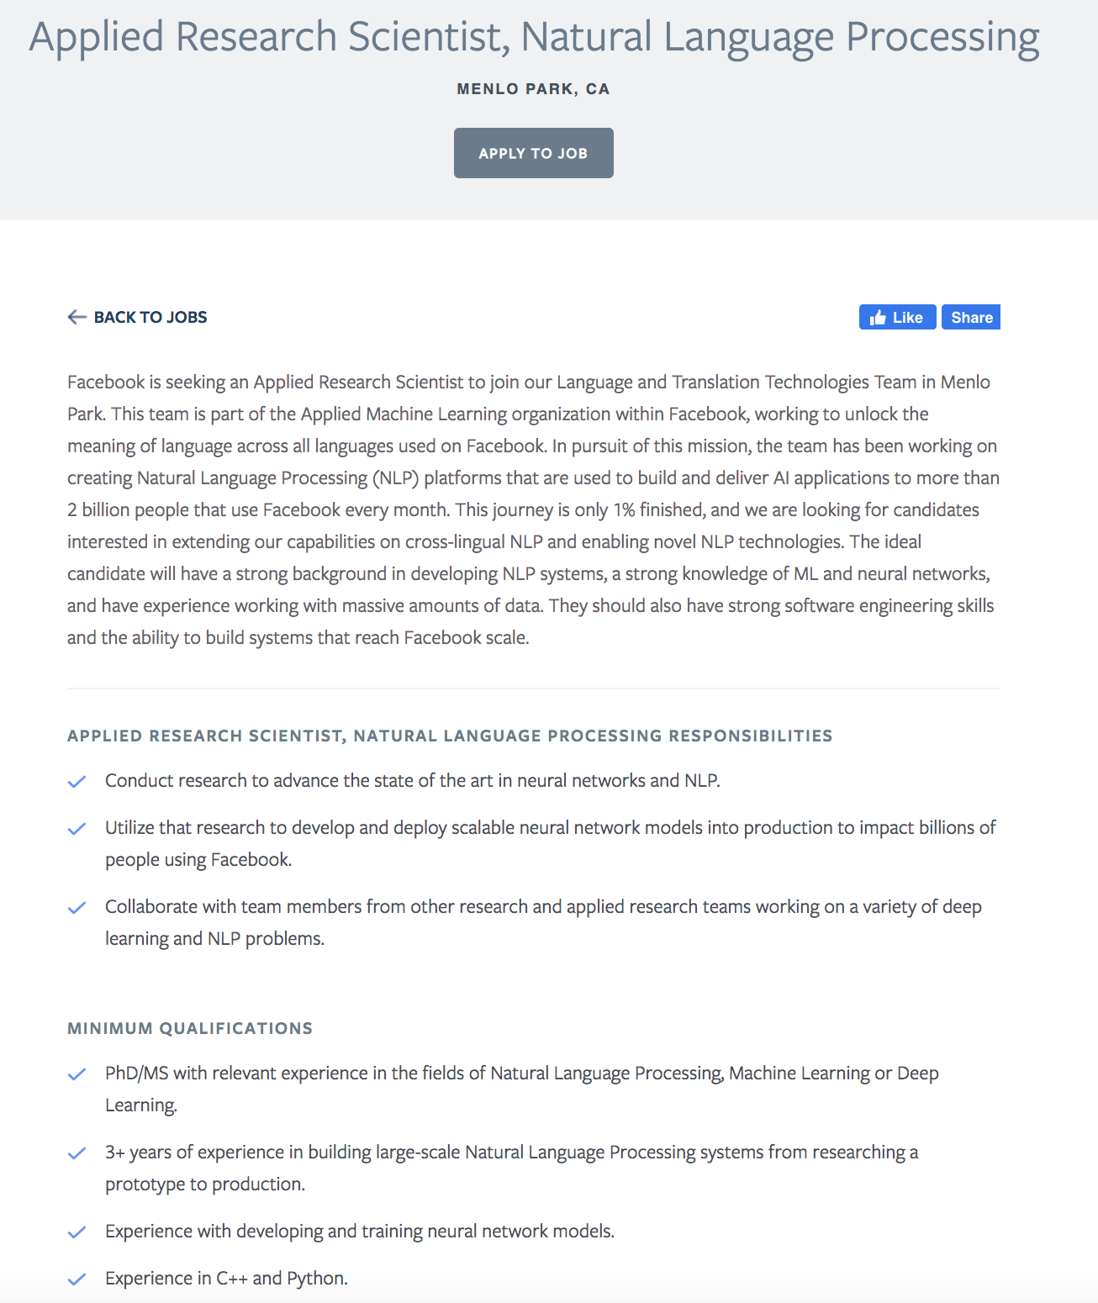
Notes:
https://www.oreilly.com/radar/data-engineers-vs-data-scientists/

Slide 18
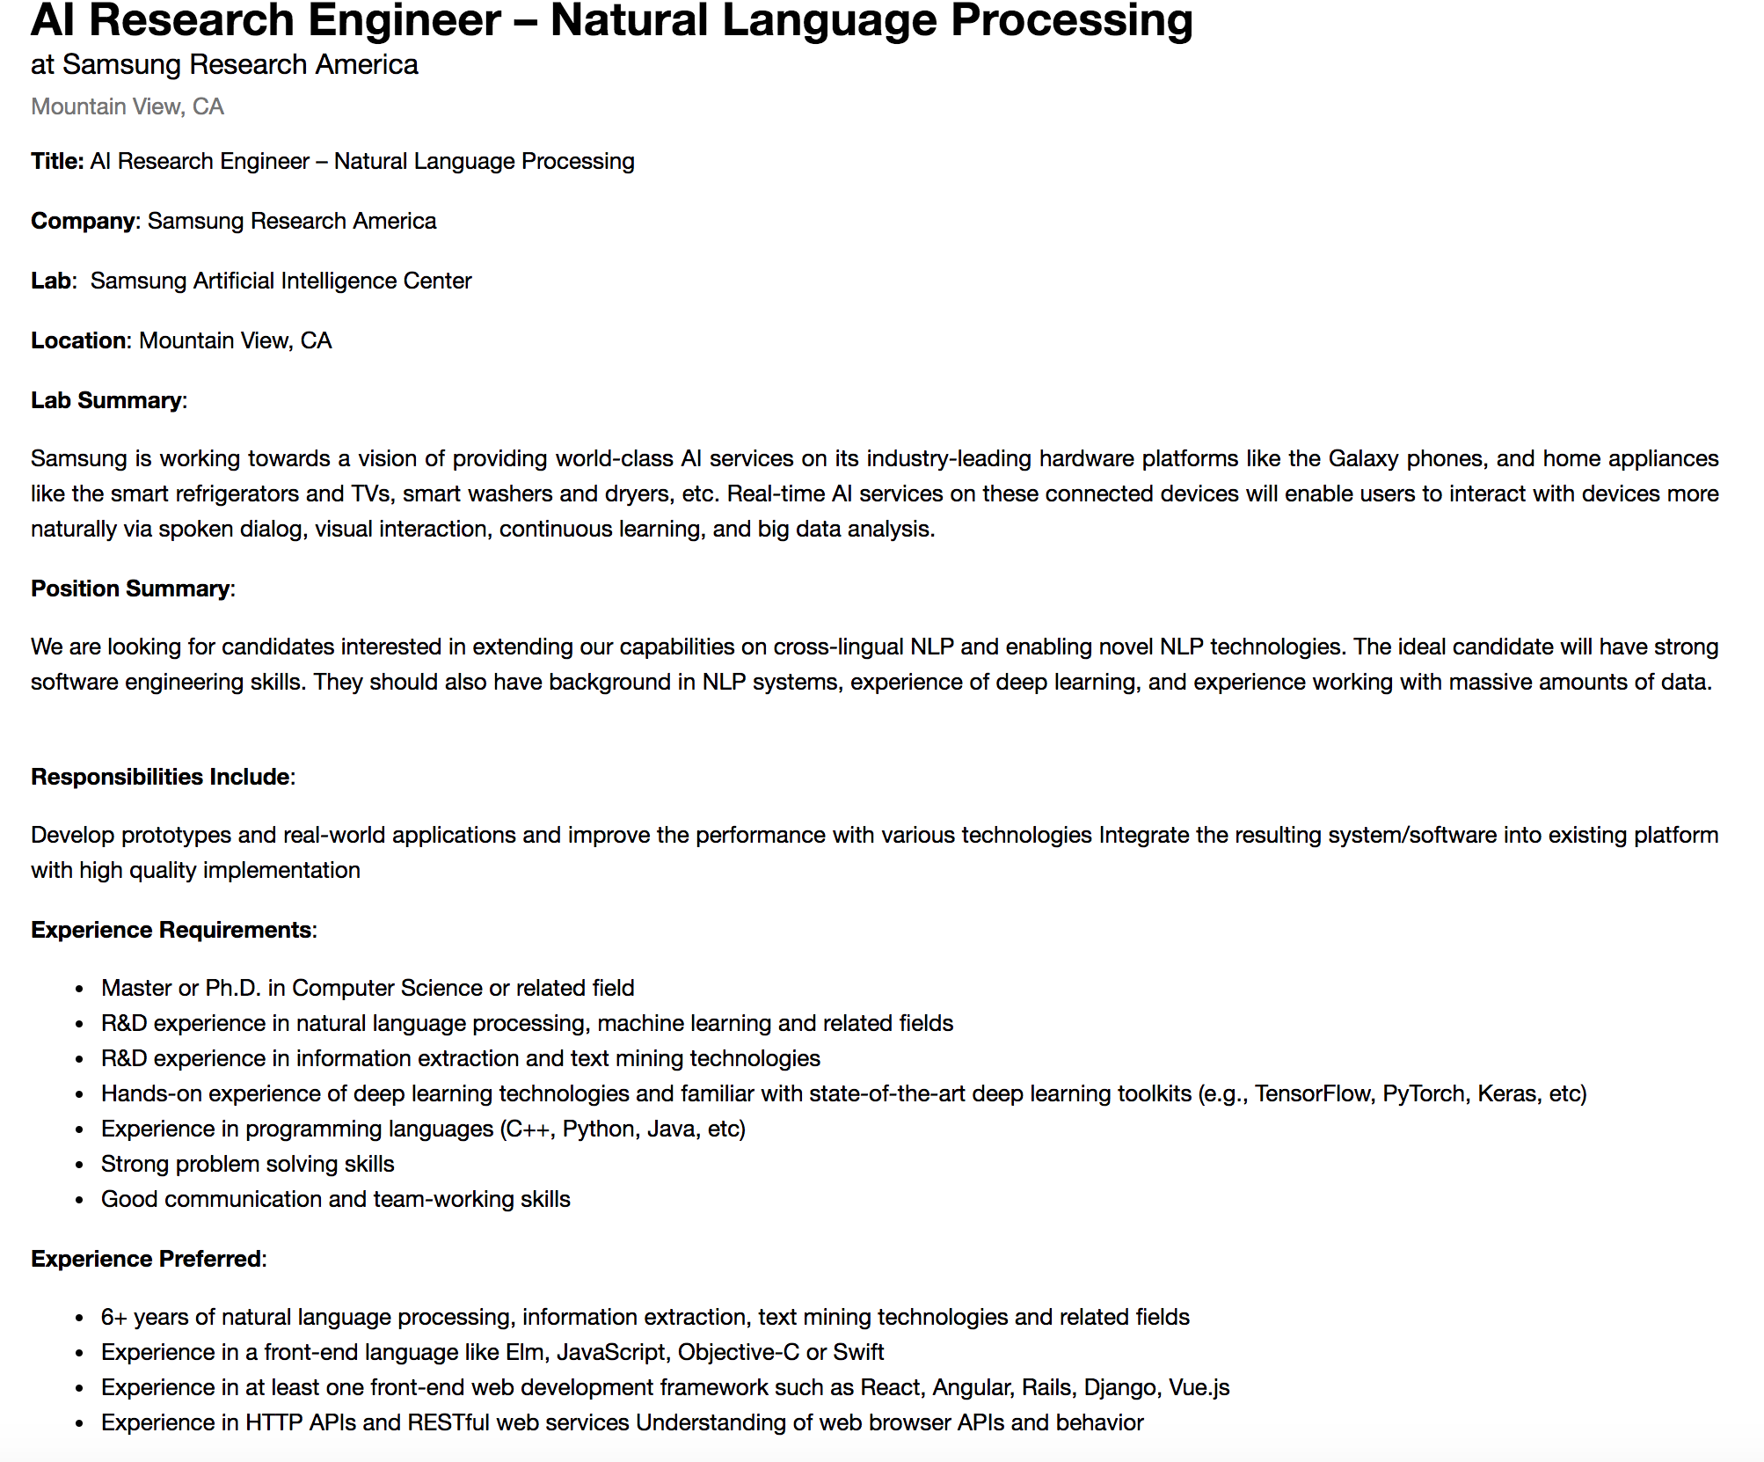
Notes:
https://www.oreilly.com/radar/data-engineers-vs-data-scientists/

Slide 19


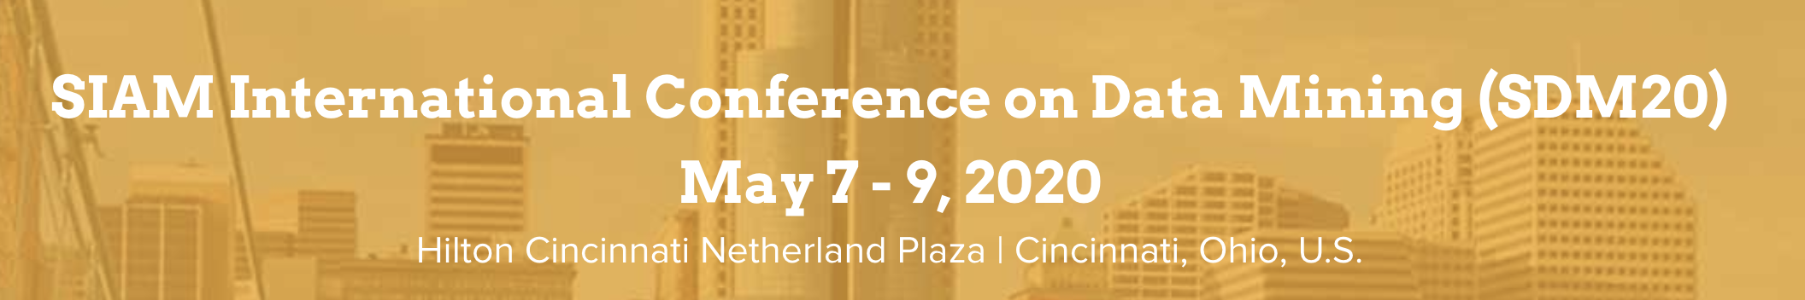
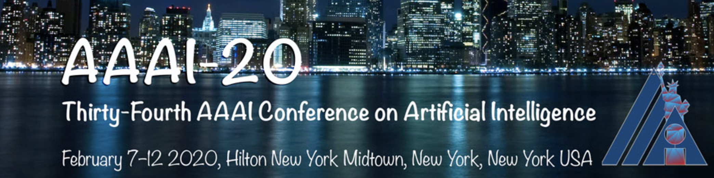

Conferences and organizations for NLP
Notes:
IADS workshop KDD 2019 https://www.iadss.org/kdd-2019-presentations

Slide 20
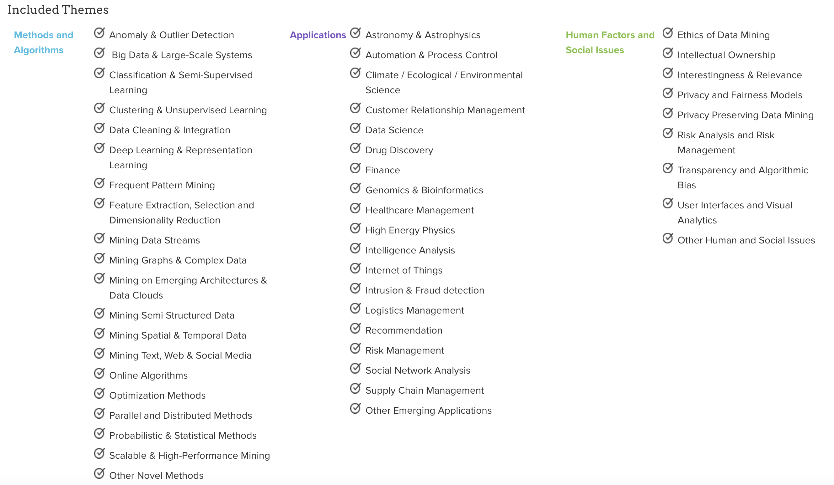
Conferences and organizations for NLP
Notes:
IADS workshop KDD 2019 https://www.iadss.org/kdd-2019-presentations

Slide 21
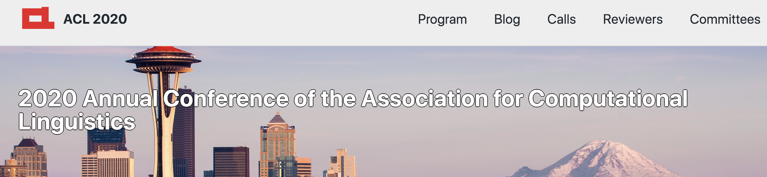
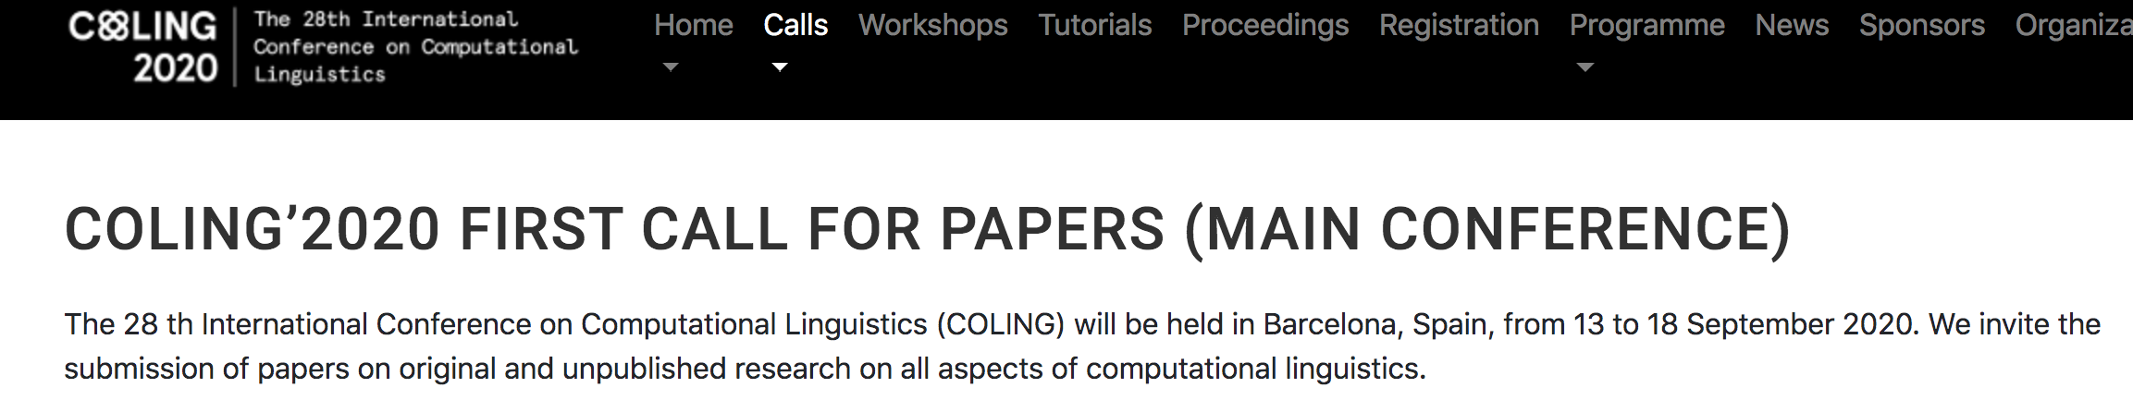
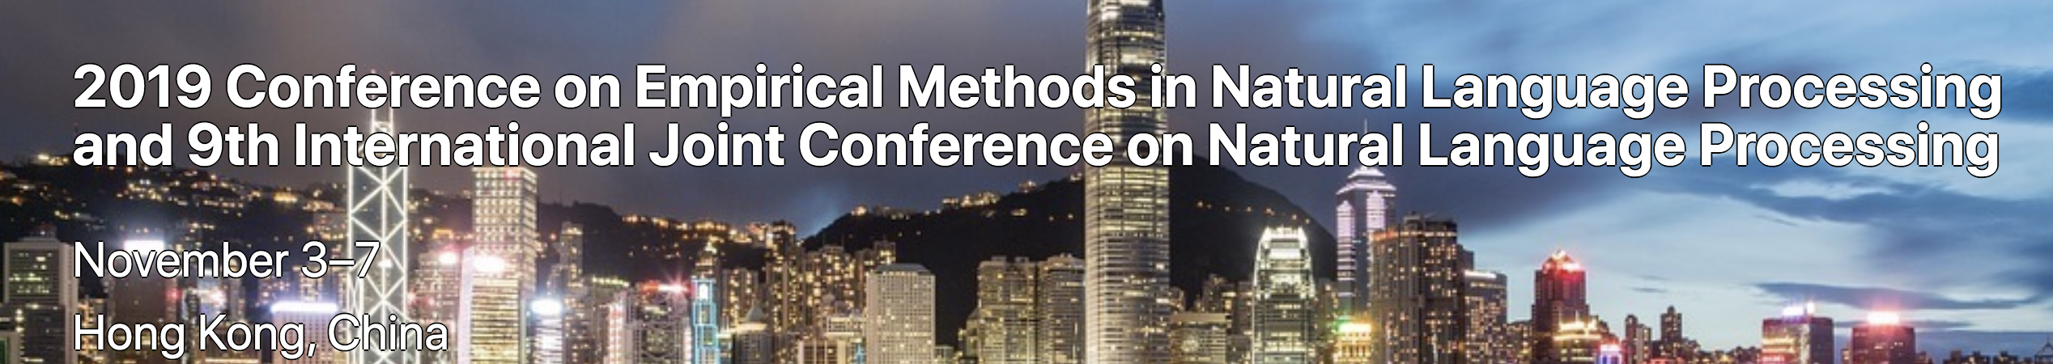
Conferences and organizations for NLP
Notes:
IADS workshop KDD 2019 https://www.iadss.org/kdd-2019-presentations

Slide 22
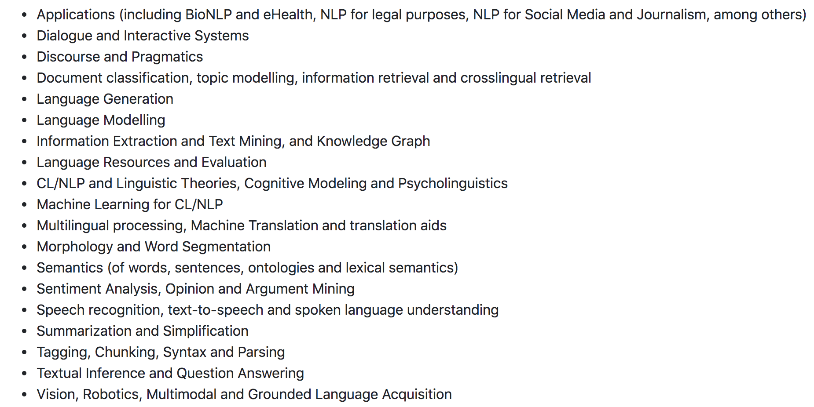
Conferences and organizations for NLP
Notes:
IADS workshop KDD 2019 https://www.iadss.org/kdd-2019-presentations

Slide 23
What did you learn today?
Questions?

